Slide 1
Pentium microprocessors
Ch-6

Slide 2
Pentium microprocessors
A 32-bit microprocessor introduced by Intel in 1993.
It contains 3.3 million transistors, nearly triple the number contained in its predecessor, the 80486 chip.
The Pentium processor has been superseded by the Pentium Pro and Pentium II microprocessors.
Since 1993, Intel has developed the Pentium III and more recently the Pentium 4 microprocessors.

Slide 3
Pentium microprocessors – P-III
Intel builds on the technology it developed with the Pentium II microprocessors.
The Pentium III processor comes with a Synchronized Dynamic Random Access Memory (SDRAM), allowing for an extremely fast transfer of data between the microprocessor and the memory.
70 new instructions, called Streaming SIMD Extensions, enhance multimedia and 3D performance.
An advanced transfer cache and system buffering are able to meet higher data bandwidth requirements.

Slide 4
Pentium microprocessors – P-III
Launched February 1999 - Available in speed levels of 450, 500, 550, and 600MHz
0.25 Micron Manufacturing Process
32KB of Level 1 Cache (operating at CPU's full core speed)
512KB of Level 2 Cache (operating at ½ of CPU's core speed)
100 MHz front-side bus speed
MMX support (MultiMedia EXtensions)
The branch prediction/recovery pipeline was doubled to include 10-stages from the P-II.

Slide 5
Pentium microprocessors – P-4
Pentium 4 is the product of a serious redesign.
The move from Pentium II to Pentium III added two million transistors.
The Pentium 4 sports a whopping 42 million - 14 million more than the currently available Pentium III Coppermine processors. (Actually, 55 million for redundancy/reliability.)
Intel's code name(Coppermine) for Pentium III CPU chips that are the first to use the .18 micron (from .25 micron) manufacturing process.

Slide 6
Pentium microprocessors – P-4
The Pentium 4 is significantly larger than its predecessor.
The P4 was first etched using the same .18-micron, aluminum trace process as the P-III Coppermine.
The current P4 etching is the .13-micron process
Now that the Pentium 4 is upon us the pipeline depth has been doubled once again to 20 stages – Net-Burst micro architecture .

Slide 7
Pentium microprocessors – P-4
To compensate for the lower IPC, Intel has implemented:
  Execution Trace Cache
  Dynamic Execution Engine
A 32-bit microprocessor, hyper-pipelined technology, a rapid execution engine and a quad-pumped 100MHz-system bus, delivering the equivalent of 3.2GB/s of bandwidth- three times the bandwidth of the Pentium III
It transfers data at the equivalent of 400MHz bus speed

Slide 8
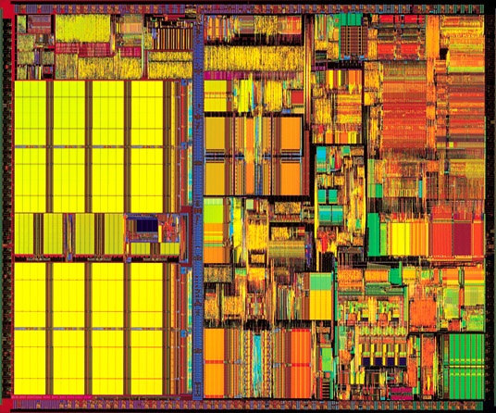
Pentium microprocessors
Logic circuits
Level 2
Cache
Level 1
Cache
Pentium III

Slide 9
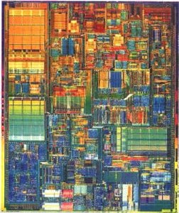
Pentium microprocessors
Increased logic circuits
Cache
Level 2
Cache
Level 1
Cache

Slide 10
Pentium microprocessors
The next generation of P4 processors will use .09 microns trace process technology.
That is 90 nanometers (90 billionths of a meter)
We are beginning to reach the limits of Silicon based chips.
Next step may be nanotechnology

